Slide 1
VBA Programming (cont.)
Week 4, Day 14

Slide 2
Reminder: make sure “Macros” are enabled
MS Office locks out custom programming by default – without warning you about it!
Go to File → Options → Trust Center → Trust Center Settings → Macro Settings
Check either “Disable all macros with notification” (will ask you whether to allow them each time you open a file with macros) or check “Enable all macros”

Slide 3
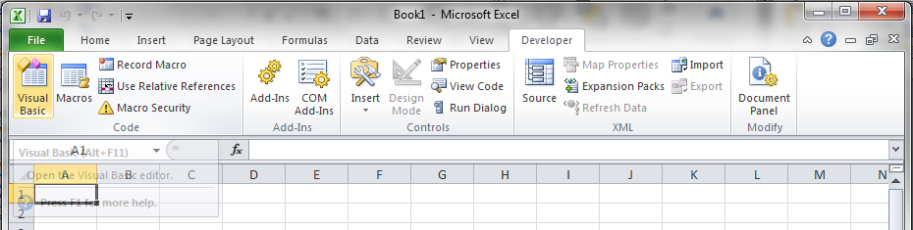
Reminder: Make“Developer” tab visible & go to VB Editor
If the Developer tab is not visible,
Go to File → Options → Customize Ribbon
On the right-hand pane, check “Developer” under “Main Tabs” & click “OK”
Go to Developer → Visual Basic (or press Alt + F11)

Slide 4
Reminder: All code goes in a “Module”
In VBA, Insert a new Module
Do NOT insert a “Class Module”
All VBA code is written in modules
All of your code for in-class exercises or homework should be in a single module!
A workbook can contain multiple modules, just as it can contain multiple worksheets
All worksheets in a workbook have access to functions written in any or all of the modules in that same workbook only

Slide 5
Function Syntax
VBA Function syntax
Function MyFunctionName(Argument1, Argument2,…)
<calculations>
MyFunctionName=<final calculation>
End Function
Function name has same rules as variable names
The argument in ( ) is like a place holder
Values assigned in order, variable names have no relationship to named cells in Excel!
Assign the function name (without the arguments) to be equal to the result of the formula you want to evaluate

Slide 6

Variables
Variables in VBA:
A variable is a named place-holder for a value,
like a cell reference in a worksheet
or a file folder with the variable name written on the outside
Variable names in VBA must start with a letter and can only contain letters, numbers, and underscore (_), and are case-sensitive. NO spaces or special characters.
A
Variable: (single-value)

Slide 7
Variable Naming Rules
Must begin with a letter
Must contain letters, numbers and underscore character only – no spaces
Can not exceed 40 characters in length
Must not be a “Reserved Word” – these are words used as part of the Excel programming language such as “Do”, “If”, or “Loop”, etc.

Slide 8
Variable Name Examples
Allowed Names
Not Allowed
a
x1x2
X1_Aname_Anyname
sum_of_numbers
1x
x1&x2
sum of numbers
Loop

Slide 9
Math syntax in VBA
VBA uses the same symbols and follows the same order of operations as Excel:
functions,
exponents (^),
multiplication/division (*, /),
addition/subtraction (+, -),
from inner-most to outer-most level of parenthesis
Math functions in VBA follow the same syntax as Excel:
Functionname(argument)

Slide 10
Math syntax in VBA
The ‘equals sign’ (=) in VBA can be used in two ways
To assign the result of a formula to a variable
As a test to see if two variables have the same value (used later)
Example of assignment: y = x * sin(x) Read this line of code as: “Set the value of the variable named ‘y’ to be equal to the result of the value of the variable named ‘x’ times the sine of the value of ‘x’.”

Slide 11
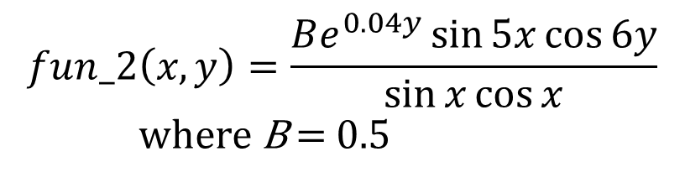
In-class Exercise #2
Write a VBA function to evaluate fun_2(x,y) for values of x and y ranging from 0 to 1 with increments of 0.1
Verify your solution with Excel functions
Hint: Don’t try to write the entire formula in one line of code. Create & use some “temporary” variables inside your function to simplify your code.
$$fun_2\left(x,y\right)=\frac{Be^{0.04y}\sin{5x}\cos{6y}}{\sin{x}\cos{x}}$$
where B = 0.5

Slide 12

In-class Exercise #3
Write a function for various values of x (in radians) ranging from 0 to 1, using built in Excel functions and also creating a user defined function in VBA
Use values for the parameters of A=2 and k=0.5 by using appropriate cell references
$$fun_3\left(A,k,x\right)=Ae^{k^{2}}\cos{x}$$

Slide 13
Sub Procedures

Slide 14
Sub Procedure Syntax
VBA Sub Procedure Syntax
Sub MySubName() Note: nothing in the parenthesis!
<Inputs>
<Calculations>
<Outputs>
End Sub
Sub procedure name has same rules as variable names
NO arguments in a Sub procedure — for our purposes, parenthesis are just place-holders (like PI function in Excel)
No built-in provision for input & output!

Slide 15
General steps to develop a program
Start with an algorithm
i.e. Develop a logical sequence of steps that solves the problem
Convert the Algorithm into a flowchart or Pseudo code
i.e. Develop a schematic chart that shows the logic of the program / write the steps in a simple language in a logical order
Convert the pseudo code to code
Write comments as you write the code! (Not after you code)

Slide 16
“Object-Oriented” Programming
Visual Basic is “object oriented”
Items are referred to in a cascade from general to specific, separated by periods
An analogy would be the description of a specific command/button in the tool ribbon
The most general object in VBA for Excel is the Excel “Application”
This is implicitly assumed and we don’t need to worry about it
Other objects:
Workbook, Worksheet, Cells, etc.

Slide 17
Object-Oriented Shortcuts
Don’t need to refer to the whole structure from the Excel application on down
Example: Range(“A1”).Font.Name=“Arial” (Application.Workbook(“Book1”).Worksheet(“Sheet1”) .Range… is assumed if Sheet1 in Book1 is “active”.)
Referring to the currently selected cell on the currently selected worksheet
Example: If cell B7 is currently selected, Range(“B7”) and ActiveCell mean the same thing, (the Application.Workbook(“Book1”).Worksheet(“Sheet1”)... part is assumed again)

Slide 18
Input Syntax
From an excel cell:
Range(“A3”).Select
a = ActiveCell.Value
From an Input box:
b = Val(InputBox(”What is b?”))
The Val( ) function converts the text output of the InputBox function into a number.
Using .Offset (we’ll cover this more later)
ActiveCell.Offset(1, 0).Select
b = ActiveCell.Value

Slide 19
Output Syntax
To an Excel cell:
Range(“A3”).Select
ActiveCell.Value = Sum
To a Message box:
MsgBox “The answer is ” & Sum
(For more details on using message box and Inputbox, type “MsgBox function” and “Inputbox function” in VBA help )

Slide 20
Text “arithmetic”
VBA can perform operations on strings of text similar to arithmetic
Concatenate two strings of text using the ampersand (&)
SomeText = “Hello ” & “World!”
NewStringVar = StringVar1 & StringVar2

Slide 21
In-Class Exercise #4
Write a Sub procedure to ask your name and reply, “Hello, …”
Sub Hello_Wk4_IC4()
’ Have VBA ask your name and greet you
’ Ask your name using an input box
MyName = InputBox(“Enter your name”)
’ Output to an Excel cell
Range(“A5”).Select
ActiveCell.Value = “Hello, ” & MyName
‘ Output to a Message box
MsgBox “Hello” & MyName
End Sub
Use comments (marked by an apostrophe) in all your code!

Slide 22
General steps to develop a program
Start with an algorithm
i.e. Develop a logical sequence of steps that solves the problem
Convert the Algorithm into a flowchart or Pseudo code
i.e. Develop a schematic chart that shows the logic of the program / write the steps in a simple language in a logical order
Convert the pseudo code to code
Write comments as you write the code! (Not after you code)

Slide 23
In-Class Exercise #5
Write a program in VBA to add three numbers
Develop Flowchart and PseudoCode
Write the code and place appropriate comments
Algorithm:
Input values for a, b, and c
Get a from a spreadsheet cell
Get b from an input box
Assign c directly in your code
Add the three values together
Output the sum

Slide 24
FlowChart and PseudoCode
Start
Start Sub procedure
Input values for a, b, c
a → input from spreadsheet
b → input from Input Box
c →input assigned in code
Calculate trisum = a + b + c
Output trisum
trisum → output to spreadsheet
→ output to Message Box
End Sub procedure
a
b
c
trisum = a+b+c
trisum
End

